Slide 1


Budget 2026-27

Slide 2

Staff
Payrise – 4% across the organisation
Re-organised Exec
New Roles in Budget
Medical team 0.8 Clinical Fellow
Community Team 0.6 Community HCA
Community Team 1 Funded Clinical Digital Educator
Clinical Team 1 Clinical Director
Fundraising Team 1 Fundraising Officer

Slide 3
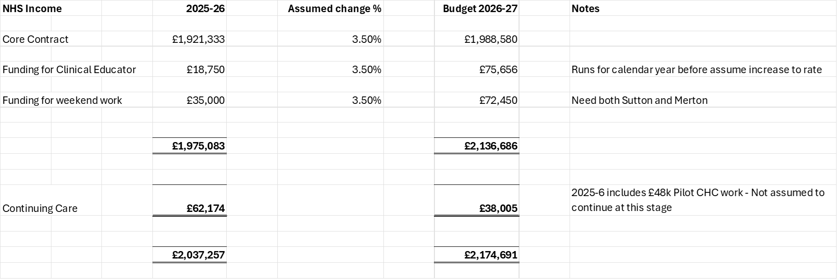
Income from NHS (£2.18m v £2.04m)

Slide 4
Fundraising Income

Slide 5
Regular Giving Growth

Slide 6
Lottery Growth

Slide 7
Retail
Until the report from the retail consultant is received the budget for 2026-27 represents a holding position with a small, below inflation increase of 2% on current levels (3% for Morden). The projections into 2027-28 still assume new shops, but this may change once the report is received. In the meantime, there is a £40k capital spend on a new venue in order to start 2027-28 on the front foot,

Slide 8
CapEx

Slide 9
Income and Expenditure Summary

Slide 10
Balance Sheet and Cash Forecast

